Slide 1
Percentages

Slide 2
Percentage
Notes:
http://www.transum.org/Software/SW/Starter_of_the_day/starter_July27.ASP

Slide 3
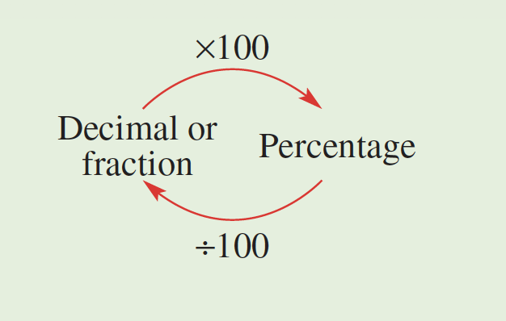
Converting percentages

Slide 4
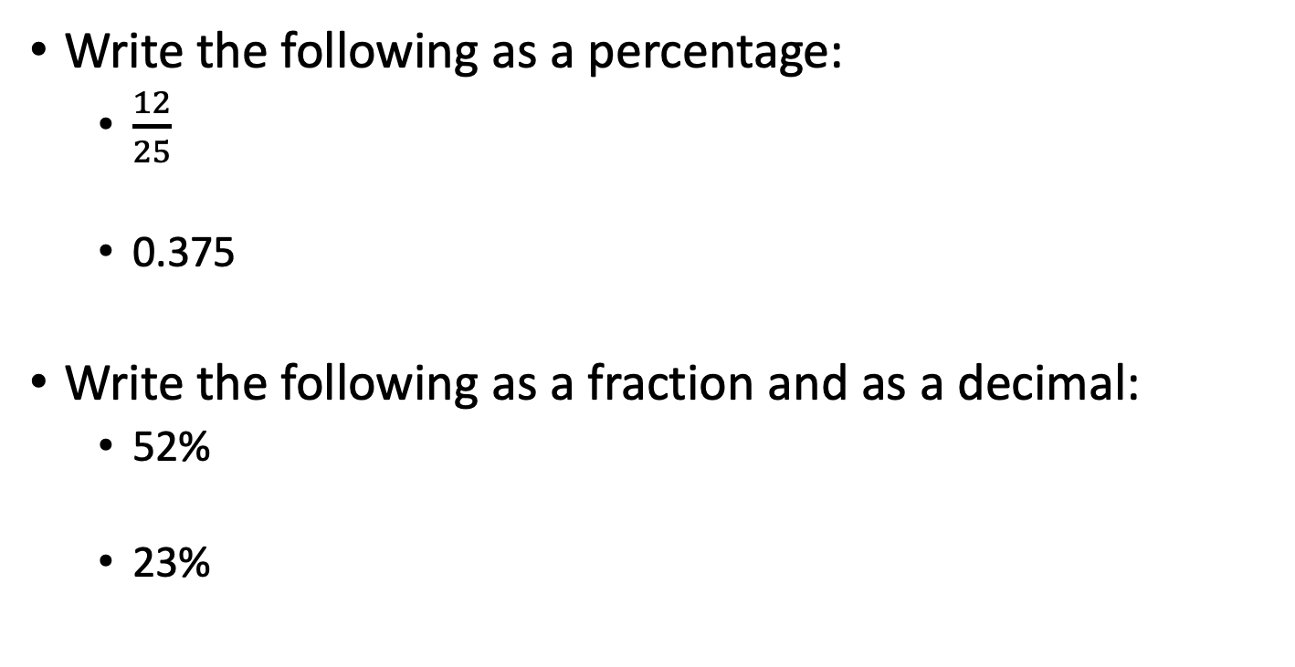
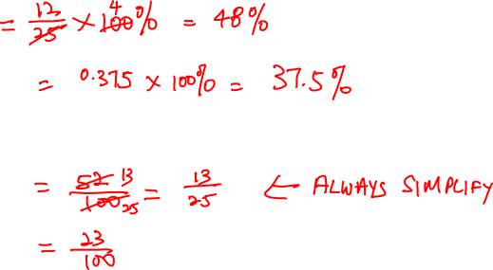
Example
Write the following as a percentage:
$\frac{12}{25}$
0.375
Write the following as a fraction and as a decimal:
52%
23%

Slide 5
Writing quantity as a percentage
Percentage of one quantity (a) of another (b)
$$\frac{a}{b} × 100\%$$
Note that a and b must be in the same unit of measurement

Slide 6
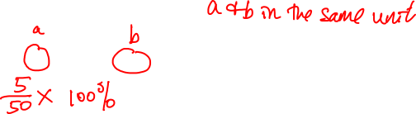
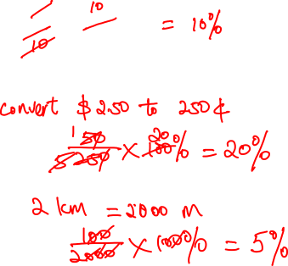
Example
Write 5g out of 50g as a percentage
Write 50c out of $2.50 as a percentage.
Write 100m out of 2km as a percentage.

Slide 7
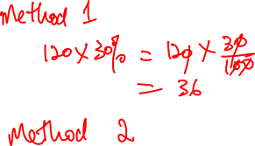
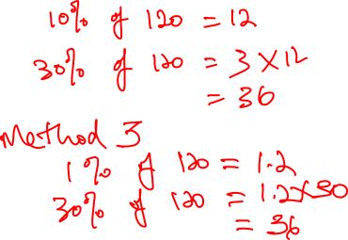
Find 30% of 120.

